Slide 1

L.L.A.M.A. Inc. (Libraries, Life, and Medical Assistance)
Empowering communities with knowledge and care

Slide 2



Slide 3

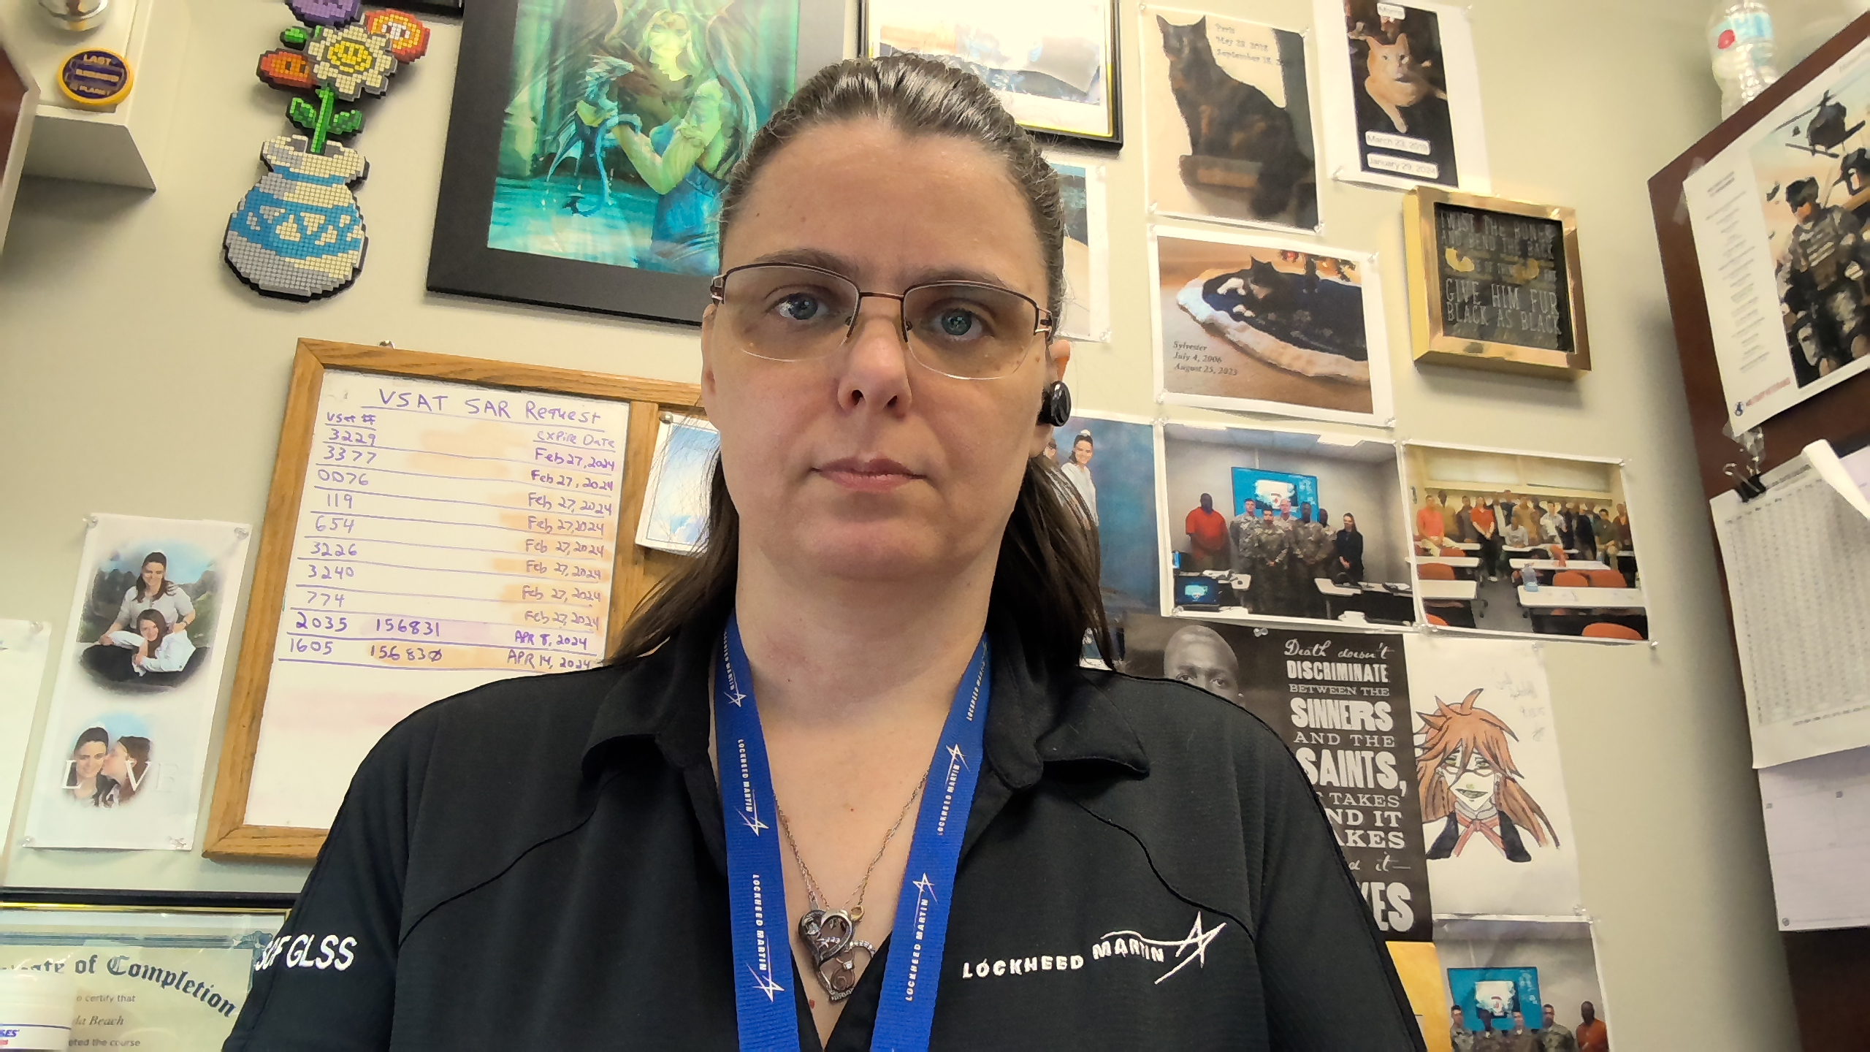


Meet the team
Jonathan Hardwick​​
Brenda Beach
Justin graves​​
Brittany smith

Slide 4
Motto: “These are the Bits You're Looking For!”

Slide 5
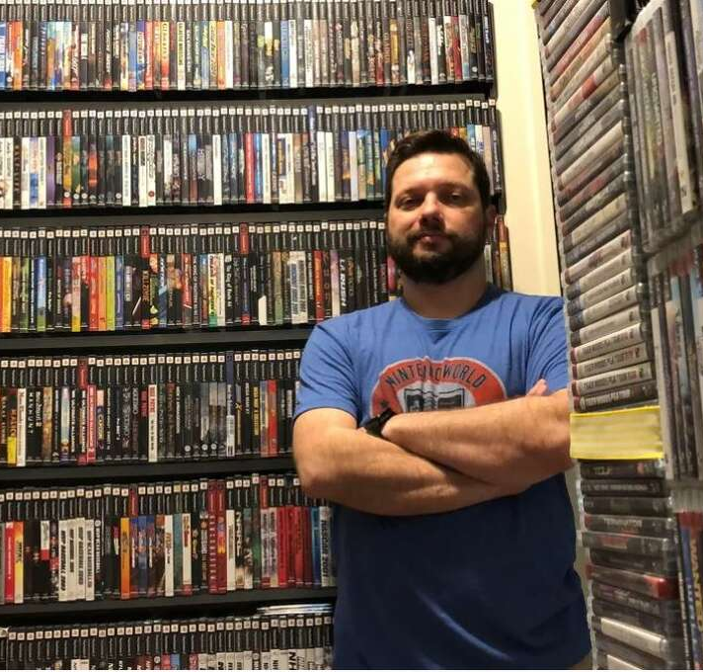
Meet Sam:
Sam has an extensive collection of video games and consoles, and he wants to create a list of his items to determine their potential worth

Slide 6
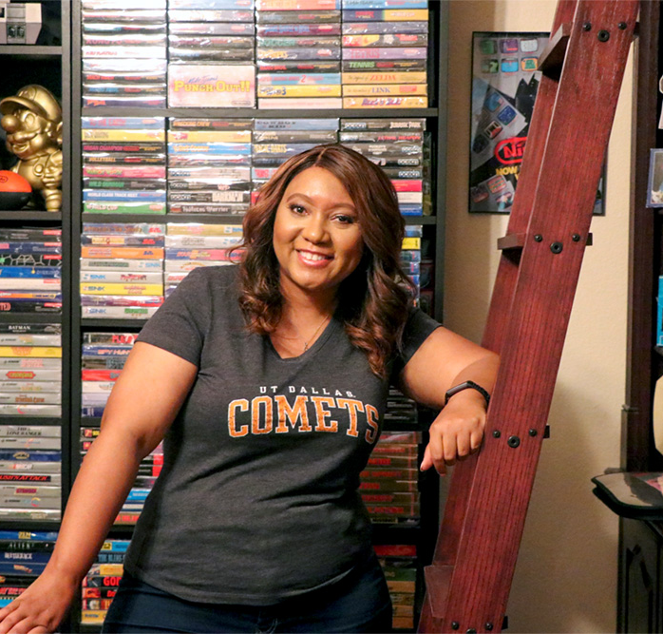
Meet Gwen:
Gwen wants to share the joy of her video game collection by selling them online.

Slide 7
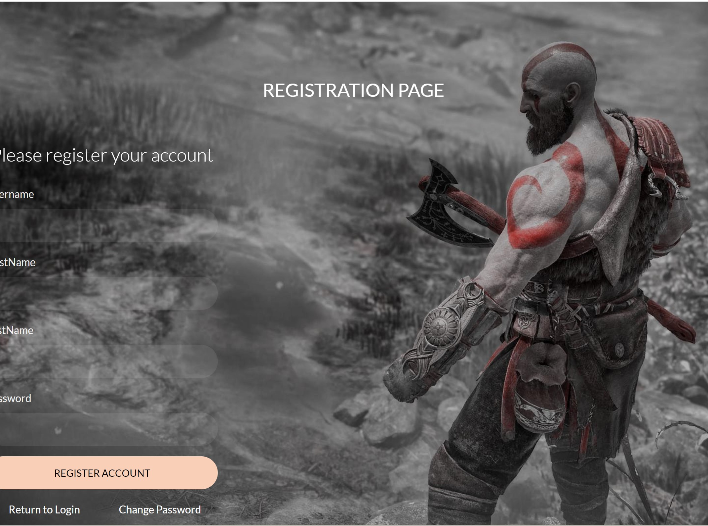
Video Game Library & Sales
User can create an account
Can create a library of all video games, consoles, and peripherals.

Slide 8
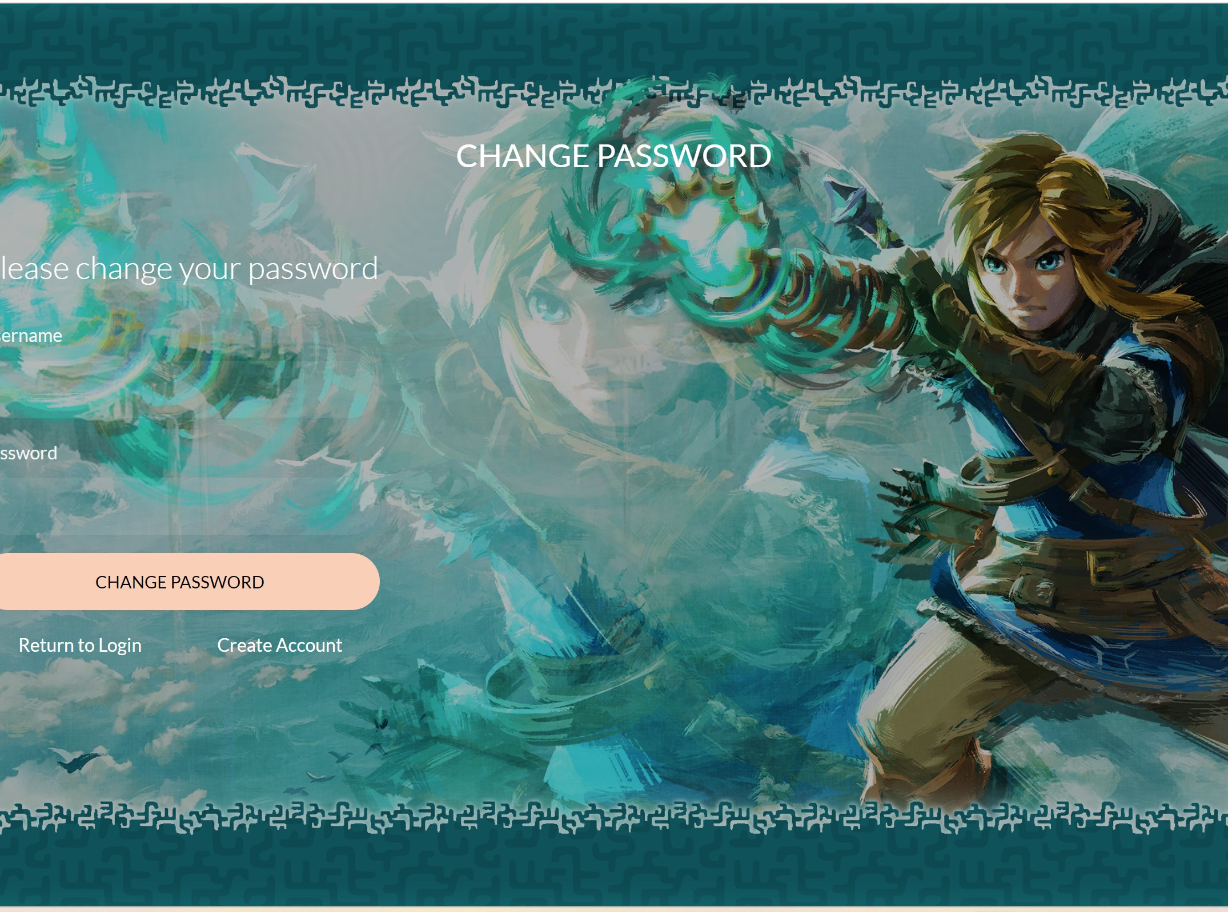
Video Game Library & Sales
If a user forgets his password, he can change it.
A user can also change his username under their account information.

Slide 9
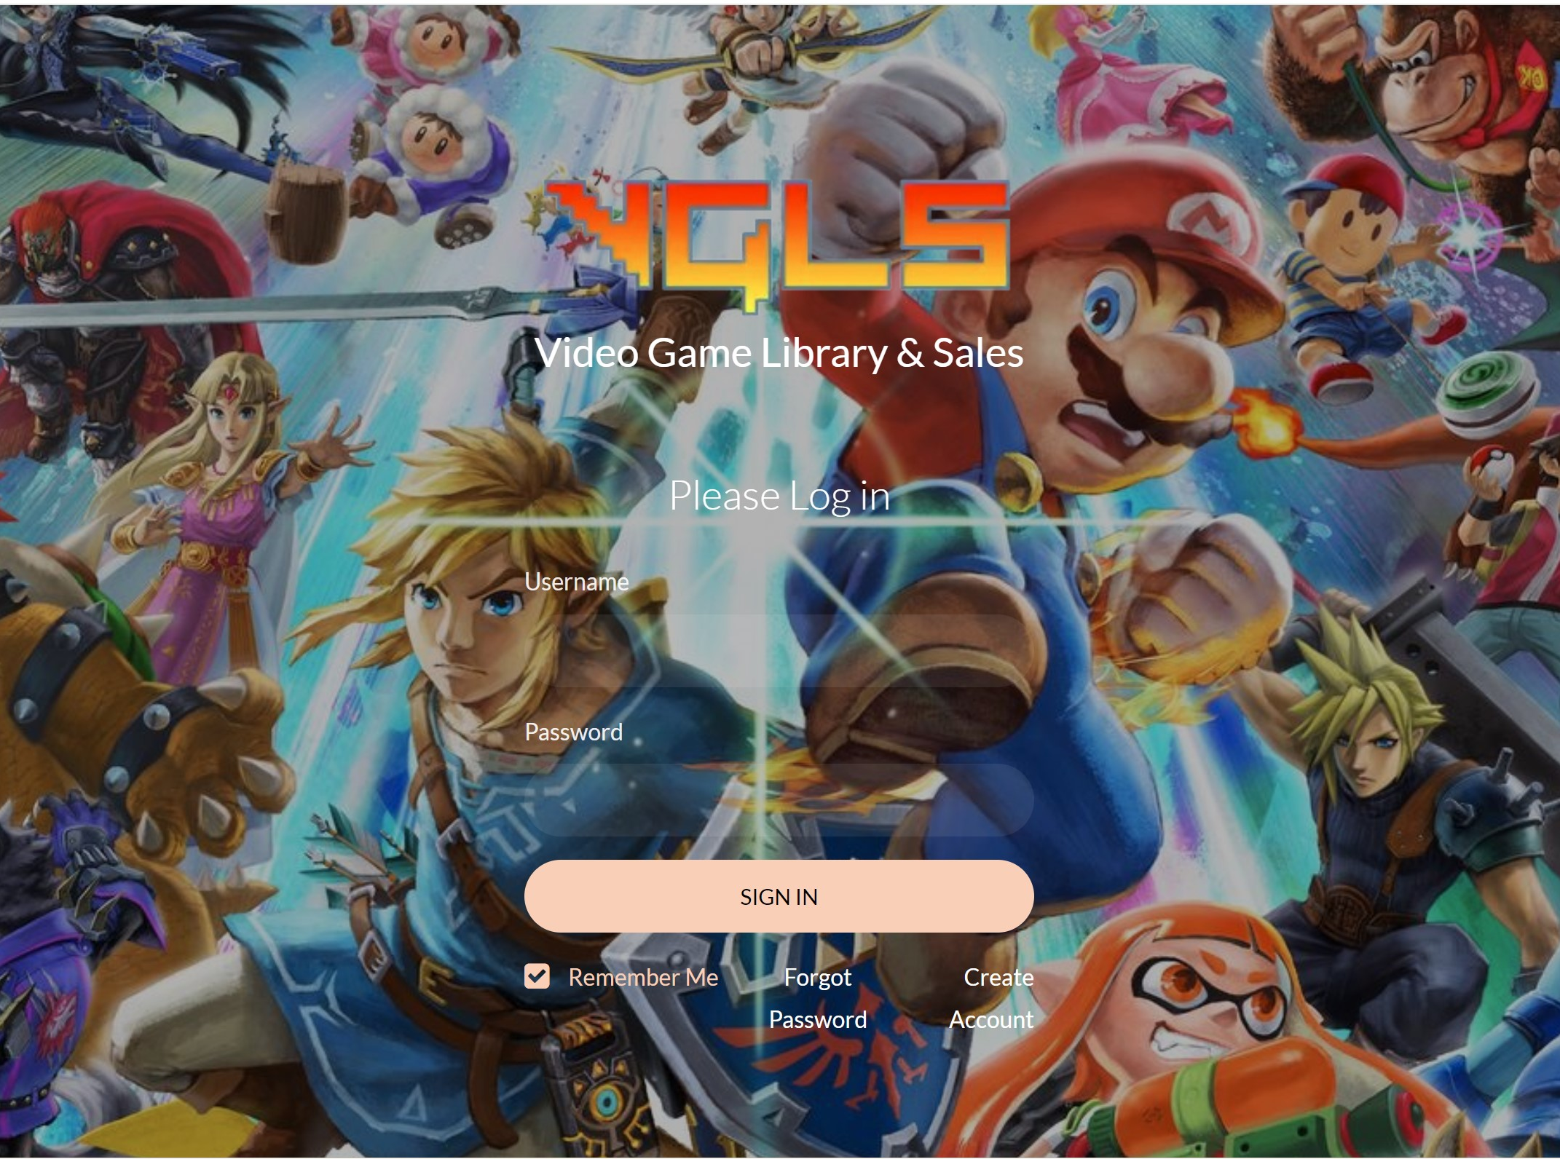
Video Game Library & Sales
The program will scrape other websites to determine the current price of the item.
The price will then be displayed in the users inventory.

Slide 10

Video Game Library & Sales
Future Plans
Allow the users to buy and sell items through the website.
Utilize an LLM to create video game recommendations to users.

Slide 11

Motto: “People Helping People”

Slide 12

The Problem:
Homeless individuals face unique challenges when trying to get help in their community. There is a lack of stable housing and limited access to services such as mental health/substance abuse programs.

Slide 13

Meet Ray:
Ray is currently living on the streets and is struggling with mental health/ substance abuse issues. He decides to reach out to a social worker for help. They then can create a localized list of resources that can help him on his journey to stable housing and recovery.

Slide 14
solution
Our mission
At Support Spot we want to make the process of getting personalized resources easier for people who are struggling with crises in our community.
Target audience
Our clients would be social workers or non-profit help organizations.
Cost saving
Reduce costs for the client by having one program they can use to find all helpful resources in our area.
Easy to use
A simple product that gives people the information they need to find the right resources for them.

Slide 15

Questions?

